Slide 1

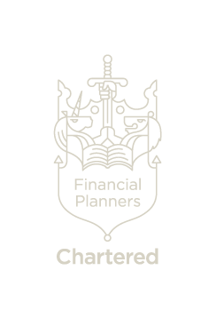
Zen Wealth
Financial Freedom and Security
Introduction to Investing
January 2019
This does not constitute advice. Professional advice should be taken prior to acting on any part of it.
Zen Wealth LLP is an appointed representative of Best Practice IFA Group Limited which is authorised and regulated by the Financial Conduct Authority.

Slide 2
Introduction
Many people today are facing difficult choices in achieving their financial goals and are asking serious questions. Our goal with this investment philosophy document is to help you see through the noise of the marketplace in order to systematically make smart decisions about your money.
Because educated investors are the most successful investors, we have created this document to help your understand how we structure our clients investments and manage their money to address five key concerns. We aim to show you a Nobel Prize–winning approach to optimize your investment portfolio over time. We have designed it specifically to not only support you in your efforts to preserve what you already have, but to also efficiently capture the market’s returns for your investments.
In addition, because we recognize that reaching your financial goals requires more than just good investment management, we have also described an approach—comprehensive wealth management—that systematically addresses your entire range of financial issues.
We believe in empowering people to make the best decisions for themselves or, if they wish, to astutely choose a financial adviser who can implement sound wealth management principles. And we believe in sharing our own financial knowledge with everyone who wants to make wise decisions about his or her money.
Zen Wealth LLP is pleased to present this to our clients and prospective clients. We sincerely hope that it will provide you with a framework for an intelligent approach to making financial decisions that will help you to achieve all your most important dreams.
The past is not necessarily a guide to future performance

Slide 3

A comprehensive approach
Money means different things to different people. Each of us has different dreams.
You may want to achieve financial freedom so that you never have to work again—even if you plan on working the rest of your life. You may want to make a top-flight university education possible for your children or grandchildren. You might want to provide the seed capital that will give your children or grandchildren a great start in life, whether that’s with a home or a business. You may dream of a holiday home on the beach or in the mountains. Or you may have achieved tremendous success throughout your career and want to leave behind an enduring legacy that will enable your favorite charity to continue its work.
Whatever your dreams are, you need a framework for making wise decisions about your money that will help enable you to achieve all that is important to you. Chances are that you have a wide range of financial goals, as well as diverse financial challenges.
Common sense tells us that such a broad range of issues requires a broad, comprehensive outlook. It’s for this reason that most affluent clients want their financial advisers to help them with more than just investments. They want real wealth management—a complete approach to addressing their entire financial lives.
As you’ve probably noticed, many financial firms these days say that they offer wealth management. The trouble is that many of these firms just provide investment management and offer a couple of extra services—such as university education planning and estate planning—and call that wealth management. So the challenge for anyone who wants help addressing all his or her financial needs is finding a firm that provides true wealth management.
The past is not necessarily a guide to future performance

Slide 4

The Wealth Management Formula
We define wealth management as a formula:
WM = IC + AP + RM
Investment consulting (IC) is the astute management of investments over time to help achieve financial goals. It requires financial advisers to deeply understand their clients’ most important challenges and then to design an investment plan that takes their clients’ time horizons and tolerance for risk into account and that describes an approach that will maximize clients’ probability of achieving their goals. It also requires financial advisers to monitor both their clients’ portfolios and their financial lives over time, so that they can make adjustments to the investment plan as needed.
Advanced planning (AP) goes beyond investments to look at all the other aspects that are important to your financial life. We break it down into four parts: wealth enhancement, wealth transfer, wealth protection and charitable giving. In our experience, very few financial advisers offer these services.
Relationship management (RM) is the final element. True wealth managers are focused on building relationships with three groups. The first and most obvious group is their clients. To address their clients’ needs effectively, they must foster solid, trusted relationships with them. Second, wealth managers must manage a network of financial professionals—experts they can call on to address specific client needs. Finally, wealth managers must be able to work effectively with their clients’ other professional advisers, such as their lawyers and accountants.
Our focus in this resource guide will be on the first element of wealth management—investment consulting. But bear in mind that managing your investments is just one part of a comprehensive approach to your financial life. At the end of this guide, we’ll describe what you should expect from a true wealth manager so that you can make an informed decision when choosing which financial professional to work with.
Let’s turn now to our discussion of the concepts that can make you a more successful investor.
The past is not necessarily a guide to future performance

Slide 5

Key Concepts for Financial Success
While investing can at times seem overwhelming, the academic research can be broken down into what we call the Key Concepts to Financial Success. If you examine your own life, you’ll find that it is often the simpler things that consistently work. Successful investing is no different. However, it is easy to have your attention drawn to the wrong issues. These wrong issues—the noise—can derail your journey.
In this section, we’ll walk through these concepts and then explain how successful institutional investors incorporate each of these concepts into their investment plans. These plans both meet their fiduciary responsibilities and achieve their financial goals. You owe yourself and your family nothing less than what the institutional investors have.
It’s important to note here that while these concepts are designed to maximize return, no strategy can eliminate risk, which is inherent in all investments. Whenever you invest, you have to accept some risk. It’s also important to remember that you’re responsible for reviewing your portfolio and risk tolerance and for keeping your financial adviser current on any changes in either your risk tolerance or your life that might affect your investment objectives.
The past is not necessarily a guide to future performance

Slide 6

A Blended Approach
Investment styles are often categorised as active or passive. An active investor is one who makes decisions about holding one investment over another. Passive investors are willing to accept the market rate of return less costs and usually enjoy paying smaller fees than active investors.
Our investment philosophy is passive (where we believe markets are efficient) to the extent that we are not making judgements on the relative merits of one investment over another, but we are not willing to accept the market rate (less fees) for our clients. Our investment process targets market-beating performance through structured exposure to dimensions of higher expected return, and uses methods of portfolio construction and implementation that enhance performance relative to the average investor.
We call this Evidenced Based Investing and it blends the best of passive and active management styles, we believe that:
the average active investor will do worse than the market because they are paying the highest fees;
the average index investor will perform slightly better than that because their fees are lower than the active investor; and
that our investment approach will outperform both due to a blend of styles, reasonable fees, exposure to dimensions of higher expected return, and intelligent portfolio implementation.
Our philosophy is based upon several key beliefs about financial markets. These beliefs lead us to construct carefully structured investment portfolios that are designed to meet the investment needs of our clients.
The past is not necessarily a guide to future performance

Slide 7

Our Core Beliefs
Capitalism Works:
Capitalism is what underpins the world’s economy and is overwhelmingly the most successful economic model that mankind has devised. The free market is a simple mechanism that brings together ideas for products and services, and the finance required to get them off the ground.
People who invest in an enterprise are taking a risk with their capital and are therefore entitled to share any financial rewards - just as they should accept any losses. This simple principle is followed in every corner of the world from the dusty markets of third-world villages to the board rooms of the world’s richest corporations. In more sophisticated markets, the rules of this process are codified by formal capital markets and most investors participate through tightly regulated exchanges of shares and bonds.
Risk and Return are related:
We believe it is impossible to improve your investment return without taking more risk. In other words, the potential for financial loss you expose yourself to in taking a risk is also the reason you earn a return. There is good risk and bad risk and higher exposure to the right risk factors leads to higher expected returns, but is no guarantee of them. Risk is the premium investors pay for the expectation of a greater return.
Our role as your adviser is first to identify which risks offer consistently higher expected returns and which do not, and then to offer you exposure to those risks in a structured, disciplined and cost effective way.
The past is not necessarily a guide to future performance

Slide 8

Markets Work:
Capital markets are the best mechanism we have to calculate the value of an asset. Many investors believe they are able to price assets more accurately than the market. They perform research and analysis to arrive at a price for an asset. If the market price is below their calculated price they might buy that asset to make a profit when it rises.
But however carefully they make their calculation; it is never more than an estimate upon which they base a prediction. Some estimates will be right; some estimates will be wrong.
Very few people are able to make consistently accurate estimates over a reasonable period of time so we do not use predictions about markets or prices in our portfolios. This principle applies across our investment philosophy which means we do not buy individual stocks we think will outperform the market; or weight investments towards countries or regions we expect to do well. Instead we use investment funds with broad exposure to the whole market and allocate assets to countries in proportion to their relative size in the global market.
We therefore accept that the market, powered by the wealth-generating capability of capitalism, provides an adequate rate of return. We do not try to beat the market with predictions; instead we harness the returns of the market through discipline and structure.
The past is not necessarily a guide to future performance

Slide 9
Diversification is Essential:
Diversification is the principle of spreading your investment risk around. Our investment portfolios therefore hold the shares and bonds of many companies and governments in many countries around the world. Because we believe in the power of capital markets rather than individual predictions or judgements, we are able to invest our clients’ assets in many thousands of individual investments. This means the negative and positive influence of each individual investment is reduced, producing, on aggregate, less risk in our portfolios.
This table ranks annual stock market performance in GBP for developed markets from highest to lowest in each of the last 25 years. The patchwork dispersion of colours shows no predictable pattern and helps illustrate why we believe it is pointless to try to predict which country will be at the top next year or the year after.
Diversification does not eliminate the risk of market loss. In British pounds. Chart is for illustrative purposes only. Past performance is not a guarantee of future results. Indices are not available for direct investment. Their performance does not reflect expenses associated with the management of an actual portfolio. Source: S&P data provided by Standard & Poor's Index Services Group. UK One-Month Treasury Bills from January 1975-present: UK One-Month Treasury Bills provided by the Financial Times Limited. Citi fixed income indices © 2017 by Citigroup. MSCI data © MSCI 2017, all rights reserved. Bloomberg Barclays data provided by Bloomberg.
The past is not necessarily a guide to future performance

Slide 10
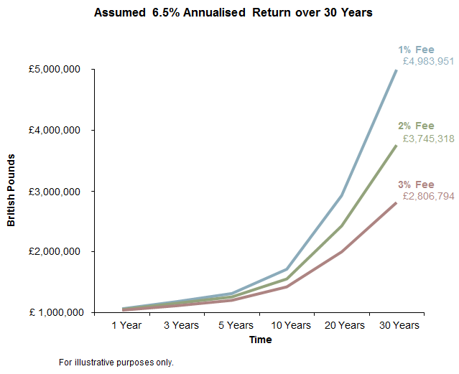
Fees Matter:
Management fees, taxes, expenses and transaction costs incurred in the management of a portfolio have a direct impact on returns, so managing costs is as important as managing investments. Good investment performance can be wiped out by high costs or a failure to seek tax efficiency. All other things beings equal and wherever possible, we seek the most cost-efficient route to market returns.
Passive investments generally cost less than the average actively managed investment by minimizing trading costs and eliminating the costs of researching stocks.
This graph shows that fees can significantly reduce net investment returns and future wealth. The higher the fees, the greater this reduction will be.
The past is not necessarily a guide to future performance

Slide 11
Information vs Noise
 |  | Market Timing
 |  | Yes |  | No
Security Selection | Yes | The Noise Quadrant Most individual investors and media coverage |  | Conventional Wisdom Quadrant Financial advisers, stockbrokers & most managed funds
 | No | Tactical Allocation Quadrant Pure market timers & asset allocation funds |  | Information Quadrant Academics Many institutional investors Zen Wealth
Markets are frenetic, energetic, ever-changing entities that require people who are actively involved in them to be constantly plugged in and switched on. But this does not mean that as an investor you must be too. This is a mistake many investors make – believing that to be a successful investor they must have their finger on the pulse all of the time.
The investment management industry and financial press perpetuates this myth with daily chatter that offers rolling tips, predictions, warnings, speculation and advice. This material is produced by competitive media and fund sales industries that survive by attracting attention to themselves. But virtually none of this information is of any real use to investors; in fact, it is distracting noise that can lead people into taking ill-advised actions. It is entertainment, not information.
Our investment philosophy is based on objective information, not noise or entertainment. Its roots are in the work of academics with no vested interest in selling investments or filling column inches.
This diagram below shows that there are 4 categories of investment style. Some investors try to time markets to their advantage and/or select securities which they believe are mis-priced.
Quadrant four is the information quadrant. This is where most of the academic community resides, along with a number of institutional investors. Investors in this quadrant dispassionately research what works and then follow a rational course of action based on empirical evidence. Academic studies indicate that the average returns of the three other quadrants are negative, not positive. This is due to high turnover, which results in additional trading costs and higher taxes. Quadrant four is where you should be, and where you’ll find all prudent investors. We are in box four.
The past is not necessarily a guide to future performance

Slide 12
Level 30
The Leadenhall Building
122 Leadenhall Street
London
EC3V 4AB
Tel: 020 3753 4638
Zen Wealth LLP is an appointed representative of Best Practice IFA Group Limited which is authorised and regulated by the Financial Conduct Authority.

